Slide 1
A practical introduction to ROS
ERNI Performance Day - October 2018
Germán Moreno

Slide 2

Overview
Bridging the gap from simple to complex robotics
What is ROS?
History of ROS
Philosophy of ROS
ROS architecture
Computation graph level
Filesystem level
Community level
ROS tools and commands
Practical examples
Swiss Software Engineering: betterask.erni

Slide 3

Swiss Software Engineering: betterask.erni

Slide 4
Bridging the gap from simple to complex robotics

Slide 5
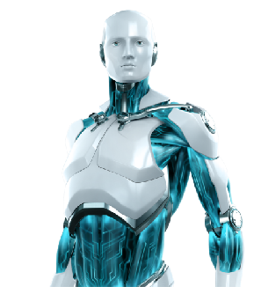
Challenges in robotics:
Robots are complex systems.
Wide diversity of robots, sensors, programming languages, etc.
World is asynchronous. Sequential programming is not suitable.

Slide 6
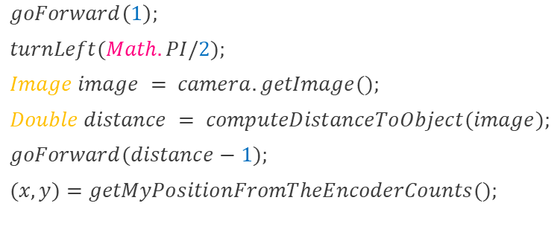
Problem 1. Sequential programming
$$goForward\left(1\right);$$
$$turnLeft(Math.PI/2);$$
$$Image image = camera.getImage();$$
$$Double distance = computeDistanceToObject(image);$$
$$goForward(distance−1);$$
$$(x,y)=getMyPositionFromTheEncoderCounts();$$
What happens if an obstacle appears when the robot is going forward?
What happens to the encoder data while the robot is turning?
What happens if some other module wants the same data?
Swiss Software Engineering: betterask.erni

Slide 7
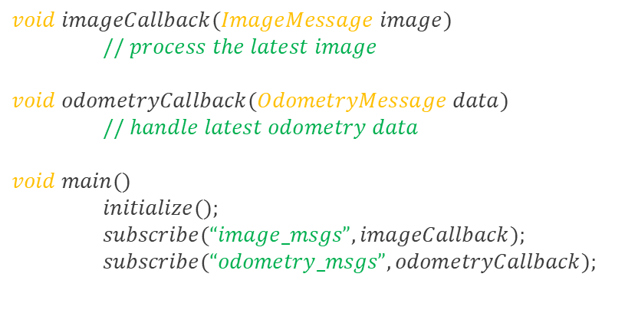
Solution 1. Callbacks
A function which is called whenever data is available. An asynchronous callback can happen at any time.
$$void imageCallback(ImageMessage image)$$
$// process the latest image$
$$void odometryCallback(OdometryMessage data)$$
$// handle latest odometry data$
$$void main()$$ $initialize();$
$subscribe(“image_msgs”, imageCallback);$
$subscribe(“odometry_msgs”, odometryCallback);$
Swiss Software Engineering: betterask.erni

Slide 8
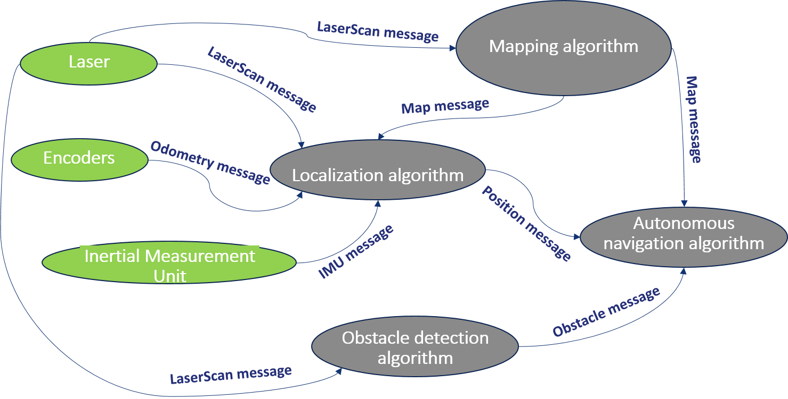
Problem 2. Complexity
Solution 2. messaging based design
Separated processes. Sensors, algorithms and high level algorithms can all be separated out. They will interact through:
Messaging interfaces. Software processes communicate each other with shared messages based on:
Publish/Subscribe method. Each process receives only the data it requests.
Swiss Software Engineering: betterask.erni

Slide 9
Problem 3. Hardware diversity
Solution 3. Hardware agnosticism
Device-specific drivers
Camera model 1
Camera model 2
Laser model 1
Laser model 2
IMU model 1
IMU model 2
Hardware-independent software
Target detection
Mapping
Localization
Image message
Image message
LaserScan message
LaserScan message
LaserScan message
LaserScan message
IMU message
IMU message
Interface
Swiss Software Engineering: betterask.erni

Slide 10


Summary
ROBOTICS NEED:
Callbacks
Separated processes that communicate through a messaging interface.
Hardware abstraction
There is a software infrastructure that enables this (among many other things) and it is called:
Swiss Software Engineering: betterask.erni

Slide 11
What is ROS?

Slide 12
What is ROS?
The Robot Operating System (ROS) is a flexible framework for writing robot software. It is a set of software libraries and tools that help to simplify the task of creating complex and robust robot applications. It provides:
Hardware abstraction
Low level device control
Message-passing between processes
Programming language independence
Implementation of a wide range of commonly used tools and algorithms
Package management
Swiss Software Engineering: betterask.erni

Slide 13
ROS history
Developed by Willow Garage, a robotics research lab and technology incubator, in 2007.
The software was released under the terms of BSD (Berkeley Software Distribution) open-source license. The primary goal was to support code reuse in robotics research.
It has been quickly adopted by many robotics research institutions and companies as their standard development framework.
http://www.ros.org/history
Swiss Software Engineering: betterask.erni

Slide 14





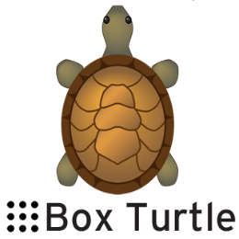





ROS Distributions
Swiss Software Engineering: betterask.erni
Box Turtle
03-2010
C Turtle
08-2010
Diamondback
03-2011
Electric
08-2011
Fuerte
04-2012
Groovy
12-2012 / 07-2014
Hydro
09-2013 / 05-2015
Indigo
07-2014 / 04-2019
(LTS)
Jade
05-2015 / 05-2017
Lunar
05-2017 /
05-2019
Melodic
05-2018 /
05-2023 (LTS)
Kinetic
05-2016 / 04-2021
(LTS)

Slide 15
ROS philosophy
Peer to Peer. Individual programs communicate over defined API (ROS messages, services, etc.).
Distributed. Programs can be run on multiple computers and communicate over the network.
Tools based. ROS is based on a microkernel design which uses a large number of small tools to build and run various ROS components.
Multi-lingual. ROS modules can be written in any language for which a client library exists (C++, phyton, java, MATLAB, etc.).
Light-weight. Stand-alone libraries are wrapped around with a thin ROS layer.
Hardware agnostic
Free and open-source. Most ROS software is open-source and free to use
Swiss Software Engineering: betterask.erni

Slide 16
ROS architecture

Slide 17

ROS architecture
ROS architecture can be described at three different levels:
Computation graph level: covers the peer-to-peer network of ROS processes, roles and communications.
Filesystem level: describes how ROS is organized and configured
Community level: describes the resources available to exchange software and knowledge across different communities.
Swiss Software Engineering: betterask.erni

Slide 18
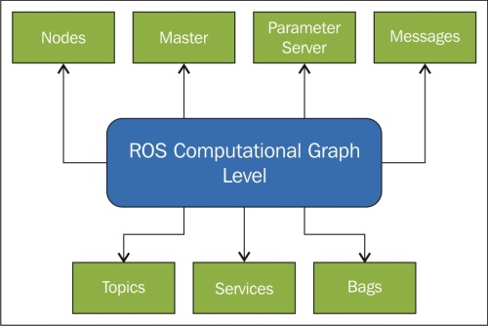
ROS computation graph level
Swiss Software Engineering: betterask.erni

Slide 19
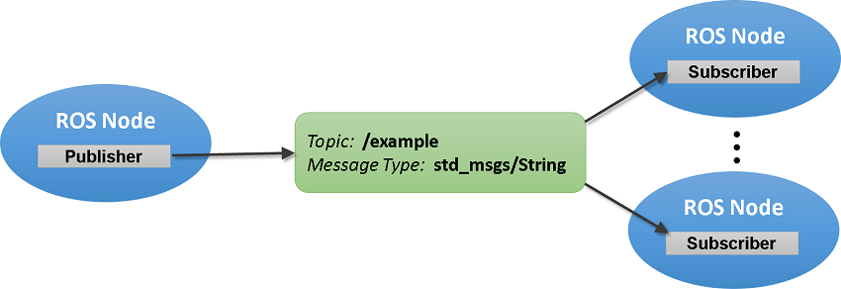
ROS computation graph level - Concepts
Nodes: Nodes are processes that performs computation. Typical examples are sensor drivers, actuator drivers, high level algorithms, user interfaces, etc. A robot system usually comprises many nodes.
Messages: A data structure used to communicate between nodes.
Topics: A node sends out a message by publishing it to a given topic. The topic is a name that is used to identify the content of the message.
Swiss Software Engineering: betterask.erni

Slide 20
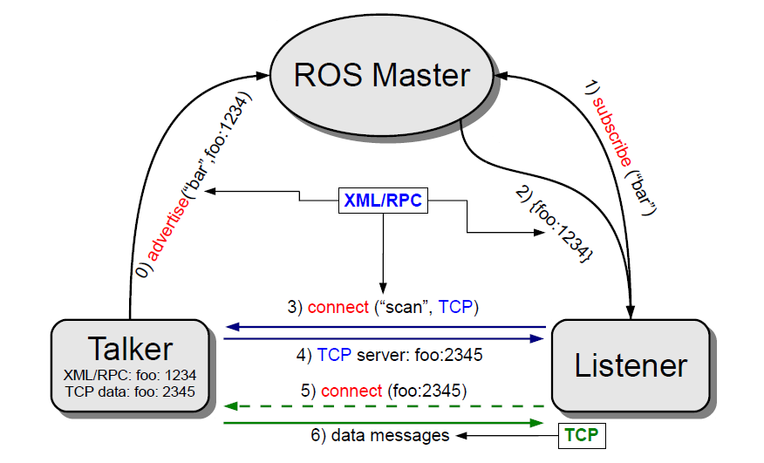
ROS computation graph level – The Master
Master: Provides name registration and lookup to the rest of the computation graph. Without the master, nodes would not be able to find each other, exchange messages or invoke services.
Swiss Software Engineering: betterask.erni

Slide 21
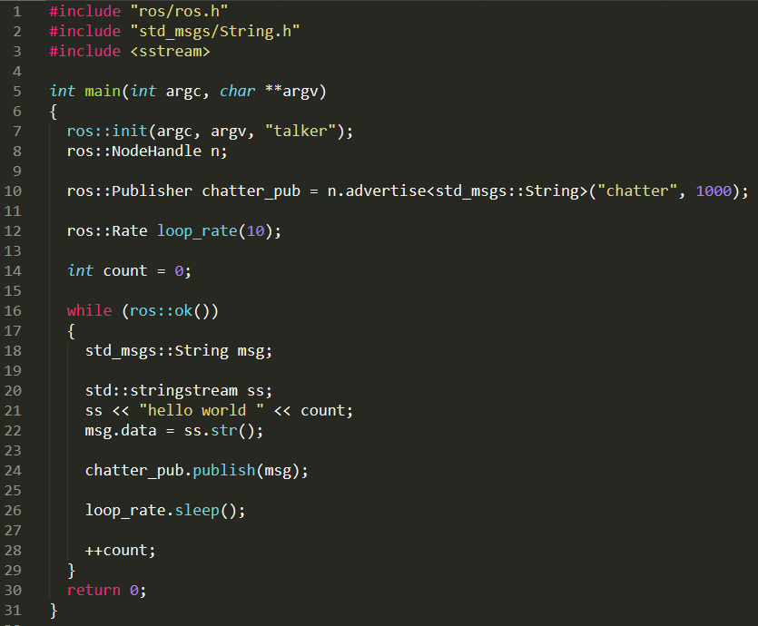
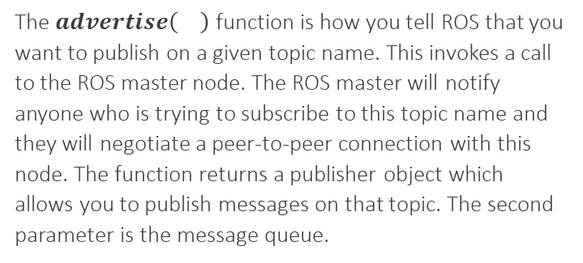
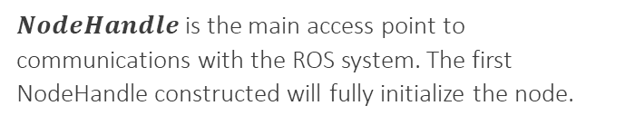
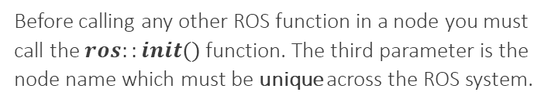
ROS computation graph level – ROS node example
Before calling any other ROS function in a node you must call the $ros::init()$function. The third parameter is the node name which must be unique across the ROS system.
$NodeHandle$ is the main access point to communications with the ROS system. The first NodeHandle constructed will fully initialize the node.
The $advertise\left(\right)$function is how you tell ROS that you want to publish on a given topic name. This invokes a call to the ROS master node. The ROS master will notify anyone who is trying to subscribe to this topic name and they will negotiate a peer-to-peer connection with this node. The function returns a publisher object which allows you to publish messages on that topic. The second parameter is the message queue.
$$talker.cpp$$
Swiss Software Engineering: betterask.erni

Slide 22
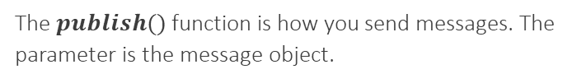
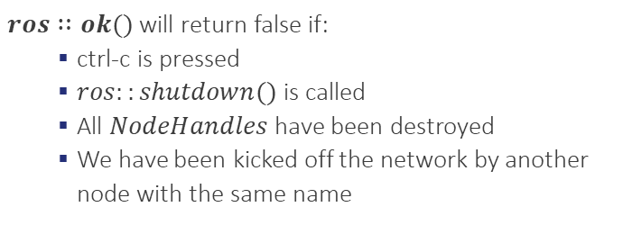
ROS computation graph level – ROS node example
$ros∷ok()$will return false if:
ctrl-c is pressed
$ros::shutdown()$ is called
All $NodeHandles$ have been destroyed
We have been kicked off the network by another node with the same name
The message object
The $publish()$ function is how you send messages. The parameter is the message object.
$$talker.cpp$$
Swiss Software Engineering: betterask.erni

Slide 23
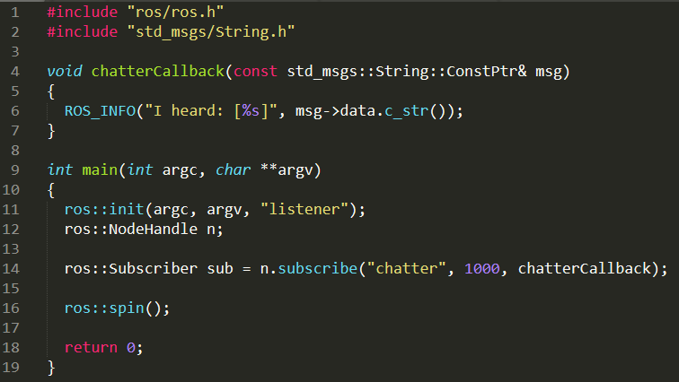
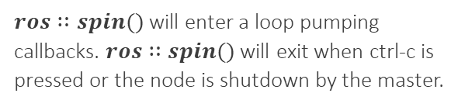
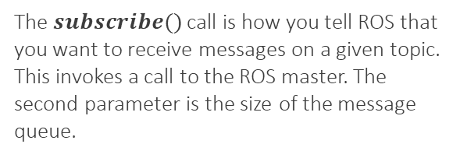
ROS computation graph level – ROS node example
This is the callback function that will get called when a new message has arrived on the chatter topic.
The $subscribe()$call is how you tell ROS that you want to receive messages on a given topic. This invokes a call to the ROS master. The second parameter is the size of the message queue.
$ros∷spin()$ will enter a loop pumping callbacks. $ros∷spin()$ will exit when ctrl-c is pressed or the node is shutdown by the master.
$$listener.cpp$$
Swiss Software Engineering: betterask.erni

Slide 24
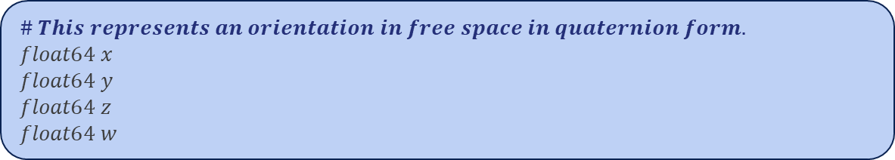


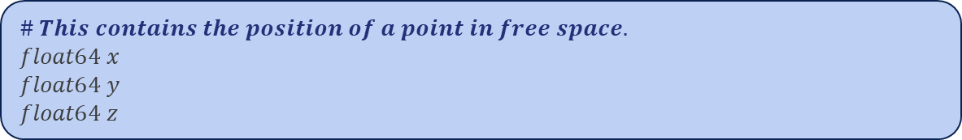

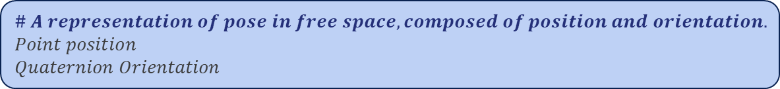
ROS computation graph level – ROS message example
$$geometry_msgs/Pose.msg$$
$$\# A representation of pose in free space, composed of position and orientation.$$
$$Point position$$
$$Quaternion Orientation$$
$$geometry_msgs/Point.msg$$
$$\# This contains the position of a point in free space.$$
$$float64 x$$
$$float64 y$$
$$float64 z$$
$$geometry_msgs/Quaternion.msg$$
$$\# This represents an orientation in free space in quaternion form.$$
$$float64 x$$
$$float64 y$$
$$float64 z$$
$$float64 w$$
Swiss Software Engineering: betterask.erni

Slide 25
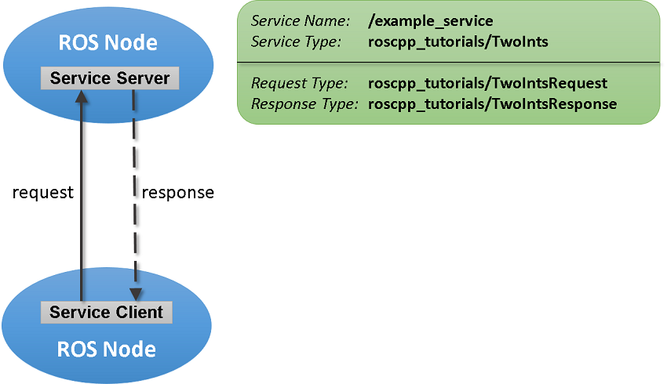
ROS computation graph level – Services
Services: The publish/subscribe model is a very flexible communication paradigm but it is not appropriate for request/reply interactions (which are often required in a distributed system). Request/reply is done via services.
Swiss Software Engineering: betterask.erni

Slide 26
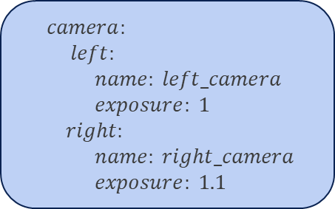
ROS computation graph level – Concepts
Bags: A format for saving and playing back ROS message data. Bags are an important mechanism for storing data, such as sensor data, that can be difficult to collect but is necessary for developing and testing algorithms.
Parameter server: Allows data to be stored by key in a central location. It is currently part of the Master. It is used for static data such as configuration parameters. Parameters can be defined in .yaml files.
$$Config.yaml$$
$camera:$
$left:$
$name: left_camera$
$exposure: 1$
$right:$
$name: right_camera$
$exposure: 1.1$
Swiss Software Engineering: betterask.erni

Slide 27
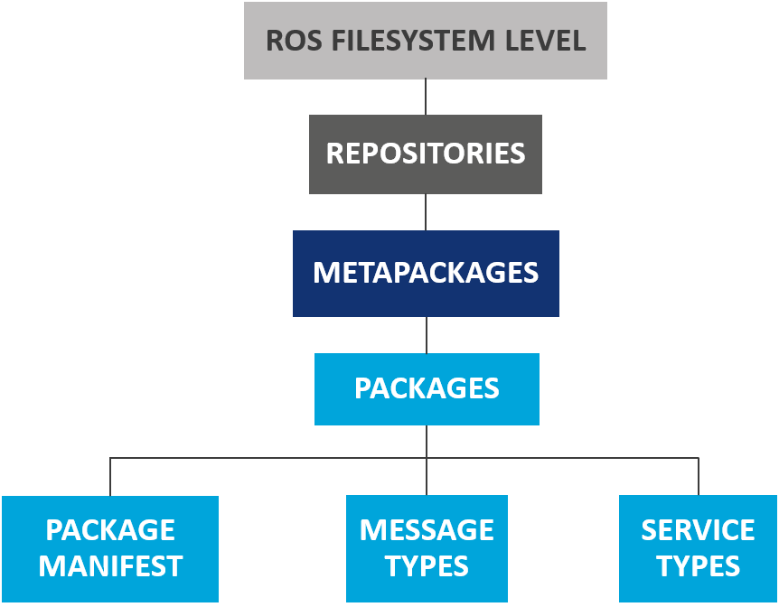
ROS filesystem level
A collection of packages which share a common VCS system
Main unit for organizing code in ROS. It contains runtime processes, ROS-dependent libraries, configuration files, etc. The most granular thing you can build and release is a package
Special packages which only serve to represent a group of packages
Service description. Define the request and response data structures for ROS services
Package metadata, including its name, version, description, license, dependencies, etc.
Message description. Define the data structures for ROS messages
Swiss Software Engineering: betterask.erni

Slide 28
ROS filesystem level – The workspace environment
ROS relies on the notion of combining spaces using the shell environment. This makes developing against different versions of ROS or against different sets of packages easier.
Default workspace
It is loaded with:
It is convenient to load it automatically every time a new shell is launched by adding this line to the bash file:
$ source opt/ros/<distro>/setup.bash
$ echo “source opt/ros/<distro>/setup.bash” >> ~/.bashrc
$ source ~/.bashrc
* The default workspace is already setup during ROS installation
http://wiki.ros.org/kinetic/Installation/Ubuntu
Swiss Software Engineering: betterask.erni

Slide 29

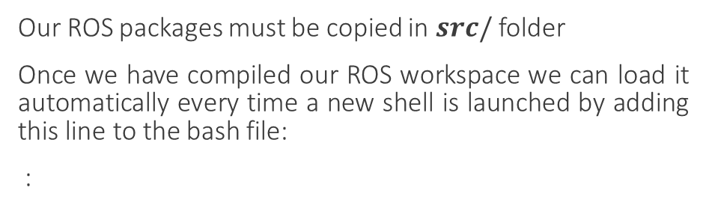
ROS filesystem level – The workspace environment
Creating a ROS workspace
$ mkdir –p /ros_ws/src/
$ cd /ros_ws/src/
erni_ws
Our ROS packages must be copied in $src/$ folder
Once we have compiled our ROS workspace we can load it automatically every time a new shell is launched by adding this line to the bash file:
:
src
build
devel
$ echo “source <path_to_ws>/erni_ws/devel/setup.bash” >> ~/.bashrc
$ source ~/.bashrc
GENERATED DURING COMPILATION
packages
Swiss Software Engineering: betterask.erni

Slide 30

ROS filesystem level – Package structure
Package_name
src
CMakeLists.txt
package.xml
msg
srv
include
launch
MANDATORY
OPTIONAL
Swiss Software Engineering: betterask.erni

Slide 31
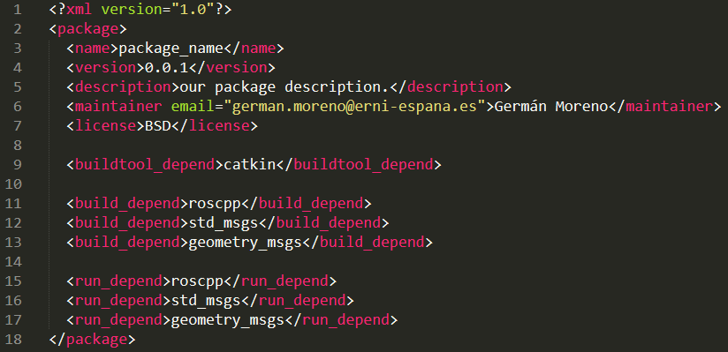
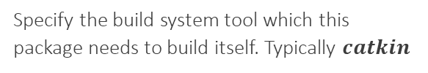
ROS filesystem level – package.xml
Package metadata, including its name, version, description, license, dependencies, etc.
Required tags!
Specify the build system tool which this package needs to build itself. Typically $catkin$
Specify which packages are needed to build this package.
Specify which packages are needed to run code in this package.
Swiss Software Engineering: betterask.erni

Slide 32
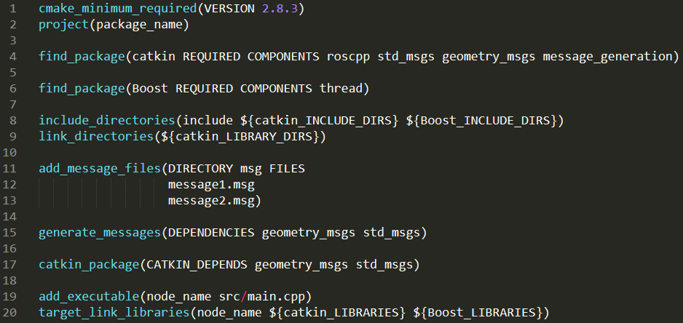
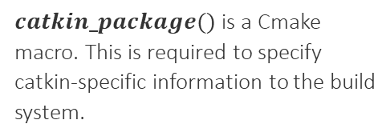
ROS filesystem level – CMakeLists.txt
It is the input to the $CMake$ build system for building software packages.
Find other CMake/Catkin packages needed for build
Invoke Message generation
$catkin_package()$is a Cmake macro. This is required to specify catkin-specific information to the build system.
* The order in the configuration DOES count!
Swiss Software Engineering: betterask.erni

Slide 33
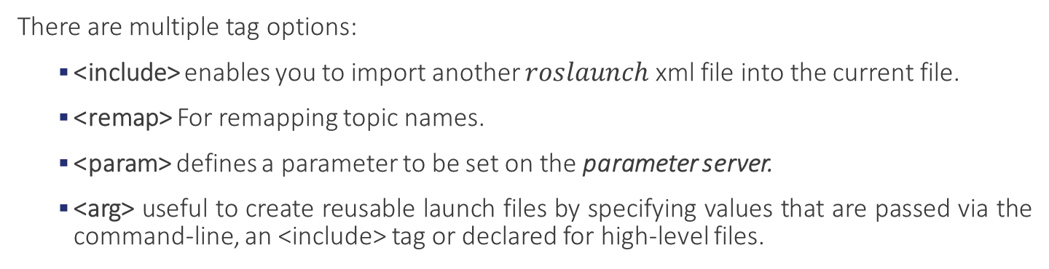
ROS filesystem level – Launch files
ROS launch is a tool for launching multiple nodes. Are written in XML as *.launch files. If not yet running, ROS launch automatically starts the master.
$$Simple launch file example$$
There are multiple tag options:
<include> enables you to import another $roslaunch$ xml file into the current file.
<remap> For remapping topic names.
<param> defines a parameter to be set on the parameter server.
<arg> useful to create reusable launch files by specifying values that are passed via the command-line, an <include> tag or declared for high-level files.
Swiss Software Engineering: betterask.erni

Slide 34
ROS Community level
Distributions. ROS distributions are collection of versioned stacks that you can install.
Repositories. ROS relies on a federated network of code repositories.
The ROS wiki. http://wiki.ros.org/Documentation main forum for documenting information about ROS.
Bug Ticket System. http://wiki.ros.org/Tickets
Mailing Lists. http://wiki.ros.org/Support primary communication channel about new updates.
ROS answers. https://answers.ros.org/questions/
Blog. http://www.ros.org/news/
Swiss Software Engineering: betterask.erni

Slide 35
ROS Tools and Commands

Slide 36
ROS Commands (I)
Filesystem management commands
$ catkin_create_pkg <package_name> [depend1] [depend2]
Creates a new ROS package
$ catkin_make
Builds a ROS catkin workspace
$ roscd <package_name>
Change directory to a package
Start-up commands
$ roscore
The basis nodes for ROS-based systems
$ rosrun <package_name> <node_name>
Runs a ROS package’s executable
$ roslaunch <package_name> <launch_file_name>
Starts a roscore (if needed), multiple nodes and set parameter server parameters
Swiss Software Engineering: betterask.erni

Slide 37
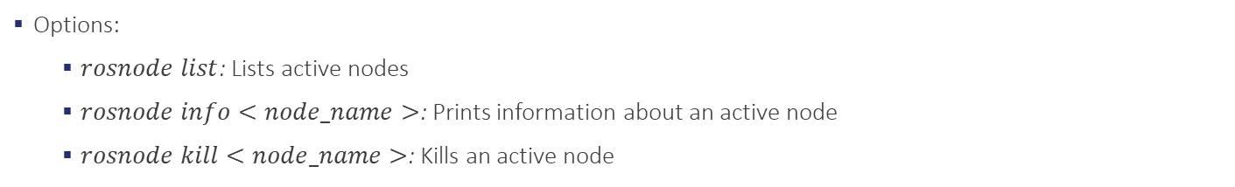
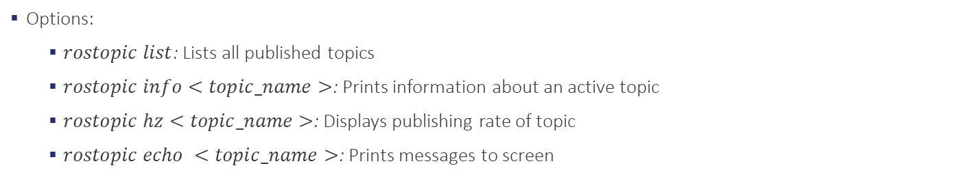
ROS Commands (II)
Introspection commands
$ rosnode
Displays debugging information about ROS nodes
Options:
$rosnode list$: Lists active nodes
$rosnode info<node_name>$: Prints information about an active node
$rosnode kill<node_name>$: Kills an active node
$ rostopic
Displays information about ROS topics
Options:
$rostopic list$: Lists all published topics
$rostopic info<topic_name>$: Prints information about an active topic
$rostopic hz<topic_name>$: Displays publishing rate of topic
$rostopic echo <topic_name>$: Prints messages to screen
Swiss Software Engineering: betterask.erni

Slide 38
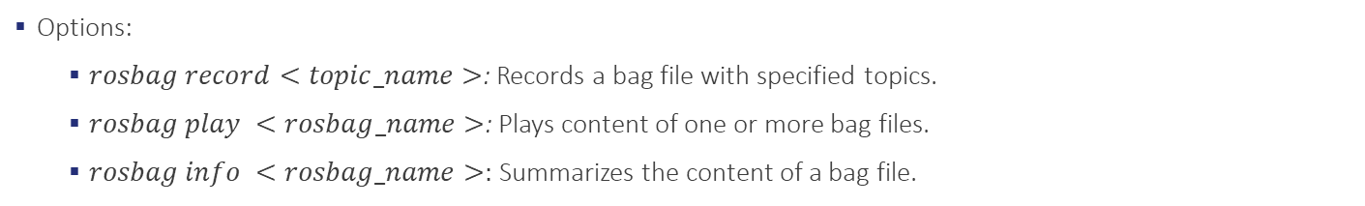
ROS Commands (III)
Logging commands
$ rosbag
A set of tools for recording and playing back ROS topics
Options:
$rosbag record<topic_name>$: Records a bag file with specified topics.
$rosbag play <rosbag_name>$: Plays content of one or more bag files.
$rosbag info <rosbag_name>:$ Summarizes the content of a bag file.
Almost all ROS commands and tools in a single document:
https://github.com/ros/cheatsheet/releases/download/0.0.1/ROScheatsheet_catkin.pdf
Wiki for all ROS commands and tools:
http://wiki.ros.org/ROS/CommandLineTools
Swiss Software Engineering: betterask.erni

Slide 39
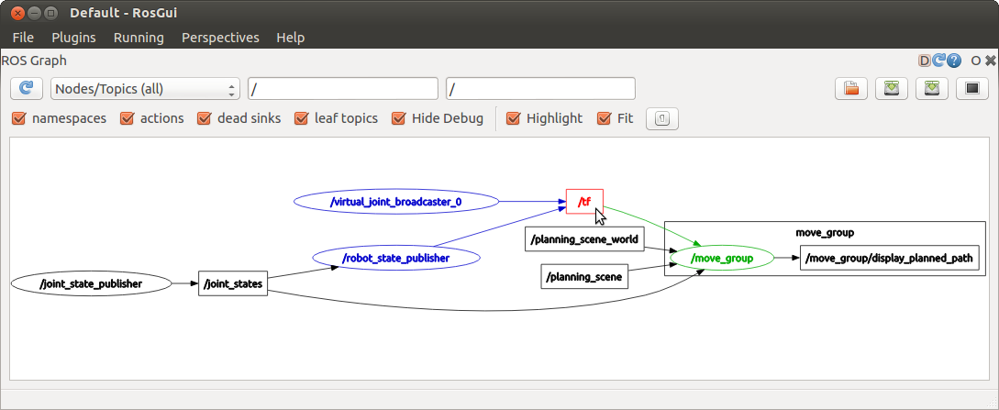
ROS Tools - rqt_graph
rqt_graph provides a GUI plugin for visualizing the ROS computation graph.
Swiss Software Engineering: betterask.erni

Slide 40
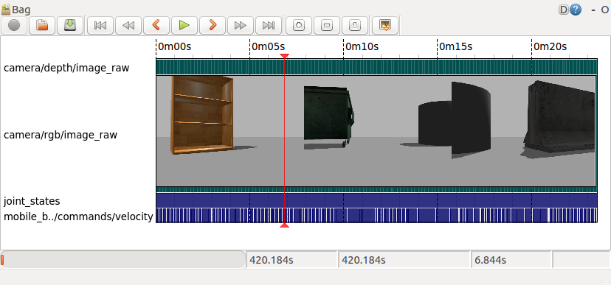
ROS Tools - rqt_bag
rqt_bag provides a GUI plugin for displaying and replaying ROS bag files.
Swiss Software Engineering: betterask.erni

Slide 41
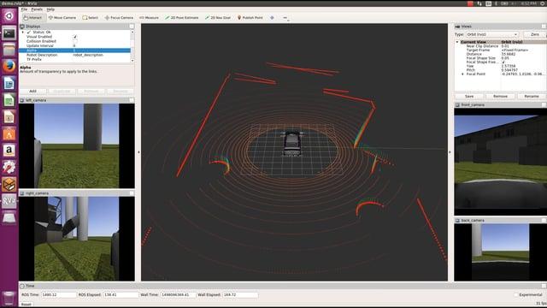
ROS Tools - RVIZ
Swiss Software Engineering: betterask.erni
3D visualization tool for ROS

Slide 42
practical examples

Slide 43



